Slide 1
Credit Risk Rating Prediction with Machine Learning
By Peter Lee

Slide 2
Overview
Introduction and Purpose
Exploratory Data Analysis (EDA)
Feature Selection
Feature Engineering
Model Fitting and Tuning
Model Evaluation
Alternative Automated Approach: AutoViML
Conclusion

Slide 3
Overview
Introduction and Purpose
Exploratory Data Analysis (EDA)
Feature Selection
Feature Engineering
Model Fitting and Tuning
Model Evaluation
Alternative Automated Approach: AutoViML
Conclusion

Slide 4
1. Introduction and Purpose
Given a dataset of clients’ risk rating, and 122 independent variables
Purpose: predicting risk rating
Use machine learning models
All procedures done with Python on Jupyter notebook

Slide 5
Overview
Introduction and Purpose
Exploratory Data Analysis (EDA)
Feature Selection
Feature Engineering
Model Fitting and Tuning
Model Evaluation
Alternative Automated Approach: AutoViML
Conclusion

Slide 6




2. Exploratory Data Analysis (EDA)
Tools used include python libraries:
pandas
numpy
matplotlib
Seaborn

Slide 7
2. Exploratory Data Analysis (EDA)
Data overview
Categorical Variables:
Country Code: 0, 1, 2
Period: combination of year and quarter (Q1 to Q4)
BR Code: integers from 0 to 107
Client: integers, IDs of clients, not informative
Continuous Variables:
Named as Variable 1 to Variable 30
Each with Y0 (current year) to Y3 (3 years ago), with two exceptions only go to Y2
Total: 118 columns (variables)
Outcome:
Risk rating (1 to 17) and Self exclusion flag (0 if risk rating > 8, 1 otherwise)

Slide 8
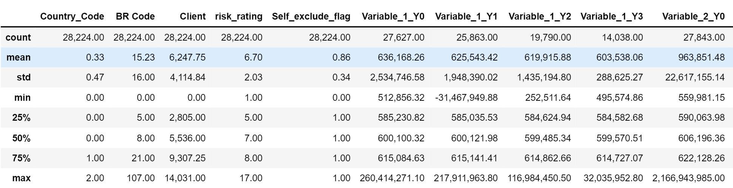
2. Exploratory Data Analysis (EDA)
Data overview – Statistics of some variables

Slide 9
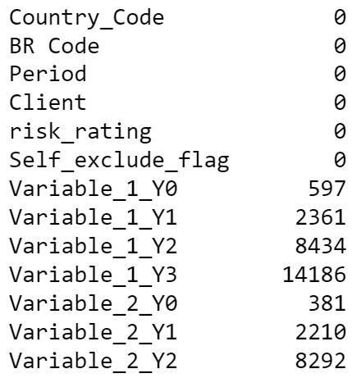
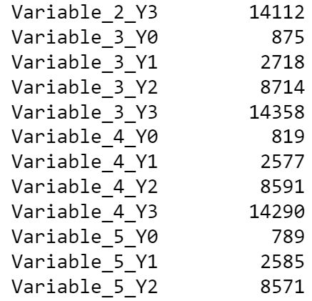
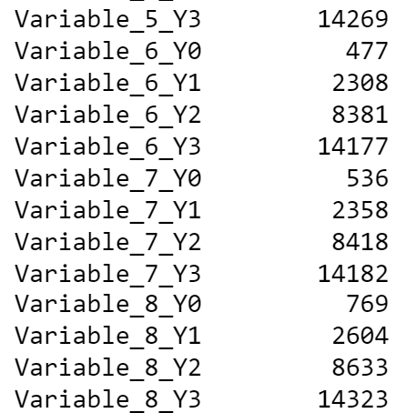
2. Exploratory Data Analysis (EDA)
Data overview – Missing data
Variable name | Number of missing data
Variable name | Number of missing data
Variable name | Number of missing data

Slide 10
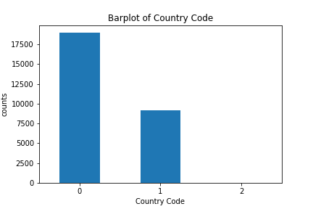
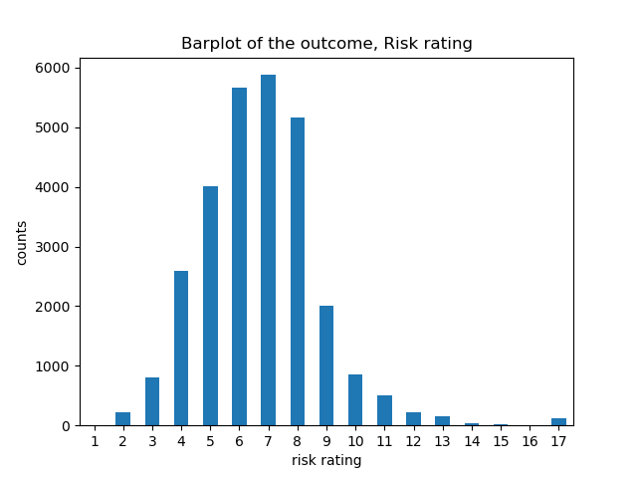
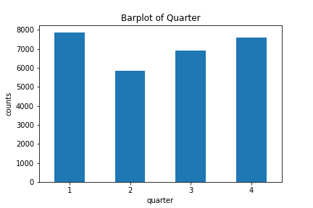
2. Exploratory Data Analysis (EDA)
Visualization – categorical variables

Slide 11
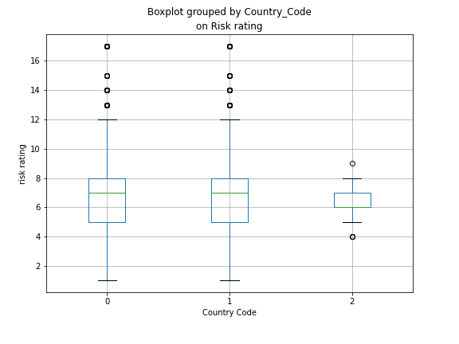
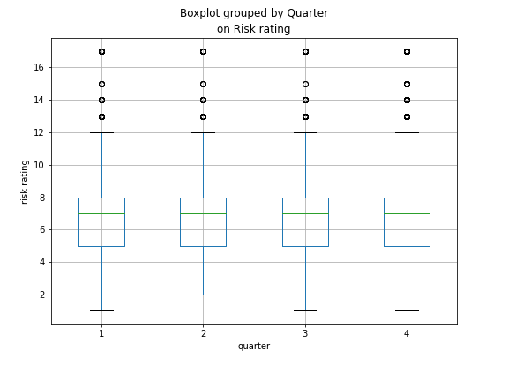
2. Exploratory Data Analysis (EDA)
Visualization – relationship between categorical variables and outcome

Slide 12
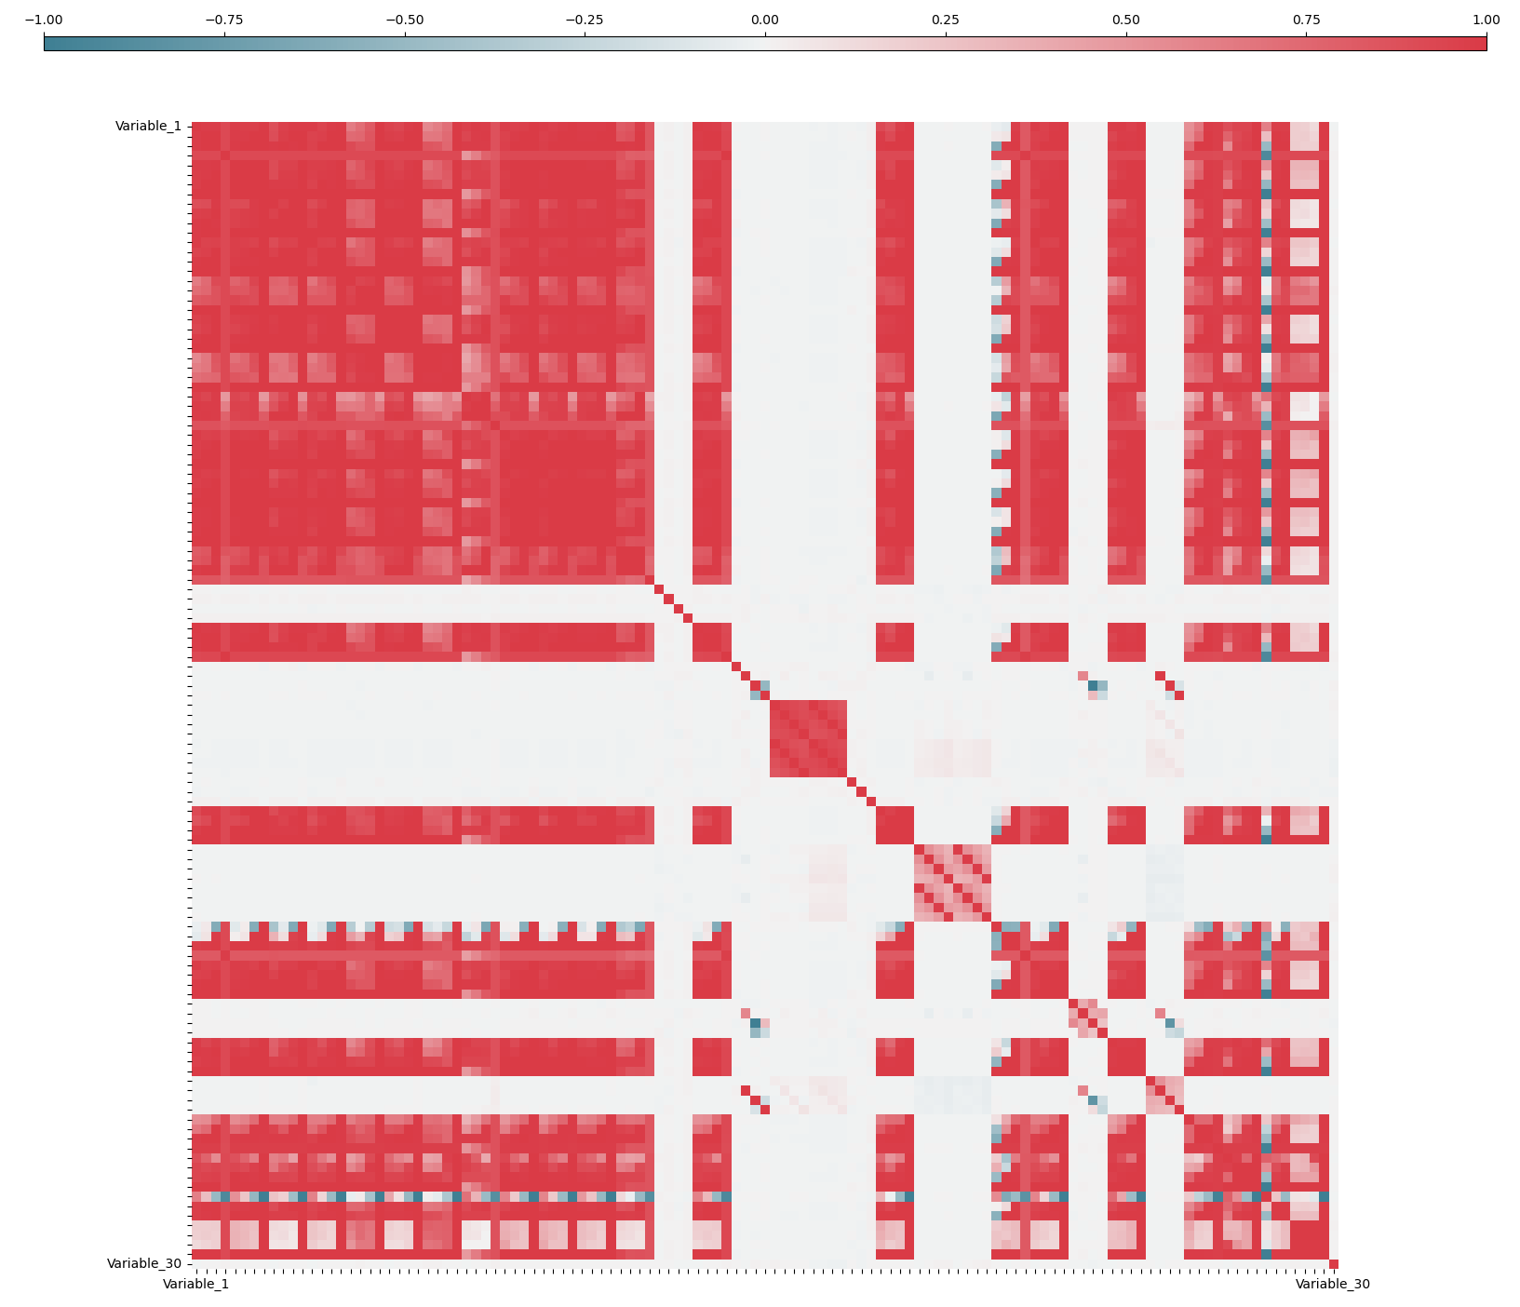
2. Exploratory Data Analysis (EDA)
Visualization – heatmap
correlation between
all independent
continuous variables
Red: 1
White: 0
Blue: -1

Slide 13
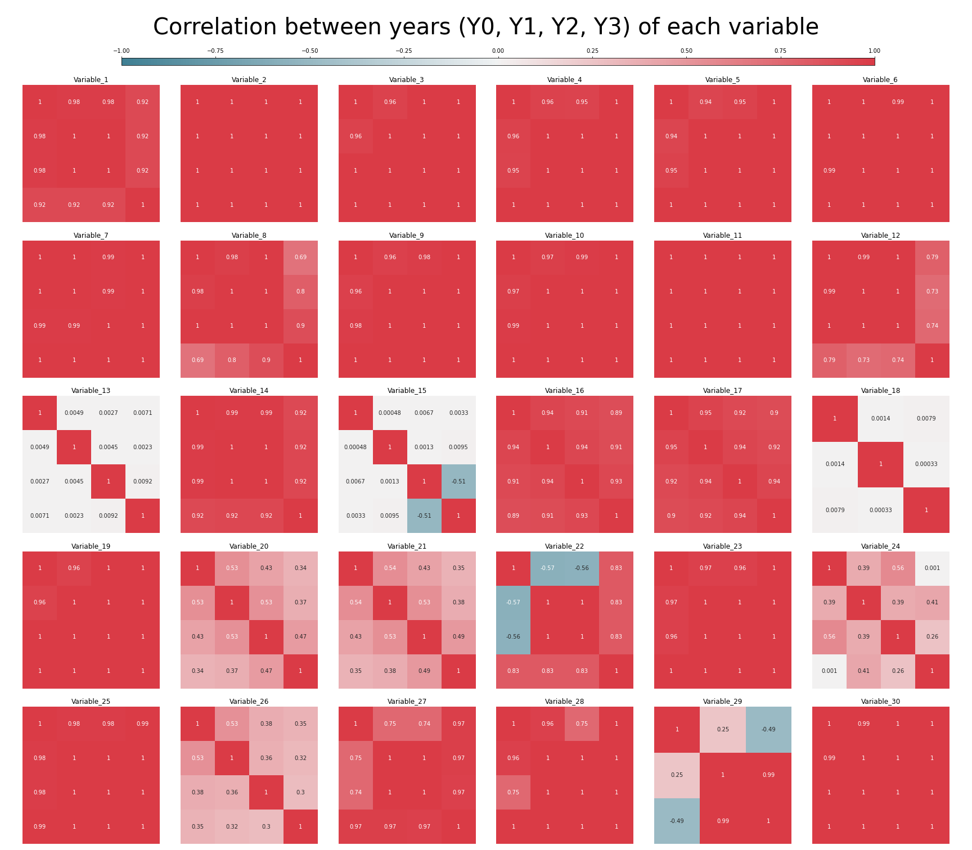
2. Exploratory Data Analysis (EDA)
Visualization – heatmap
correlation between
Y0, Y1, Y2, Y3
of each continuous variable
Red: 1
White: 0
Blue: -1

Slide 14
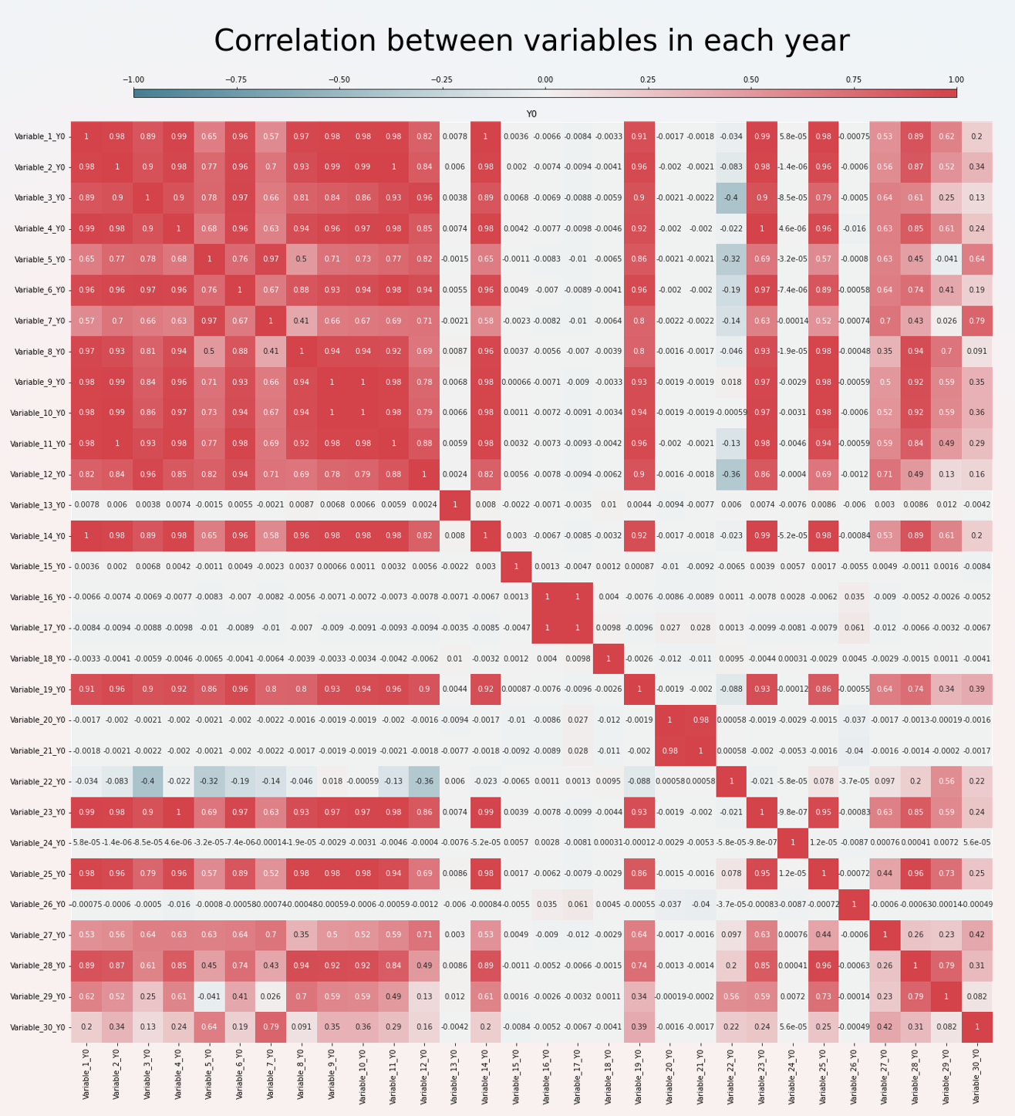
2. Exploratory Data Analysis (EDA)
Visualization – heatmap
correlation between
all independent
continuous variables
in Y0
Red: 1
White: 0
Blue: -1

Slide 15
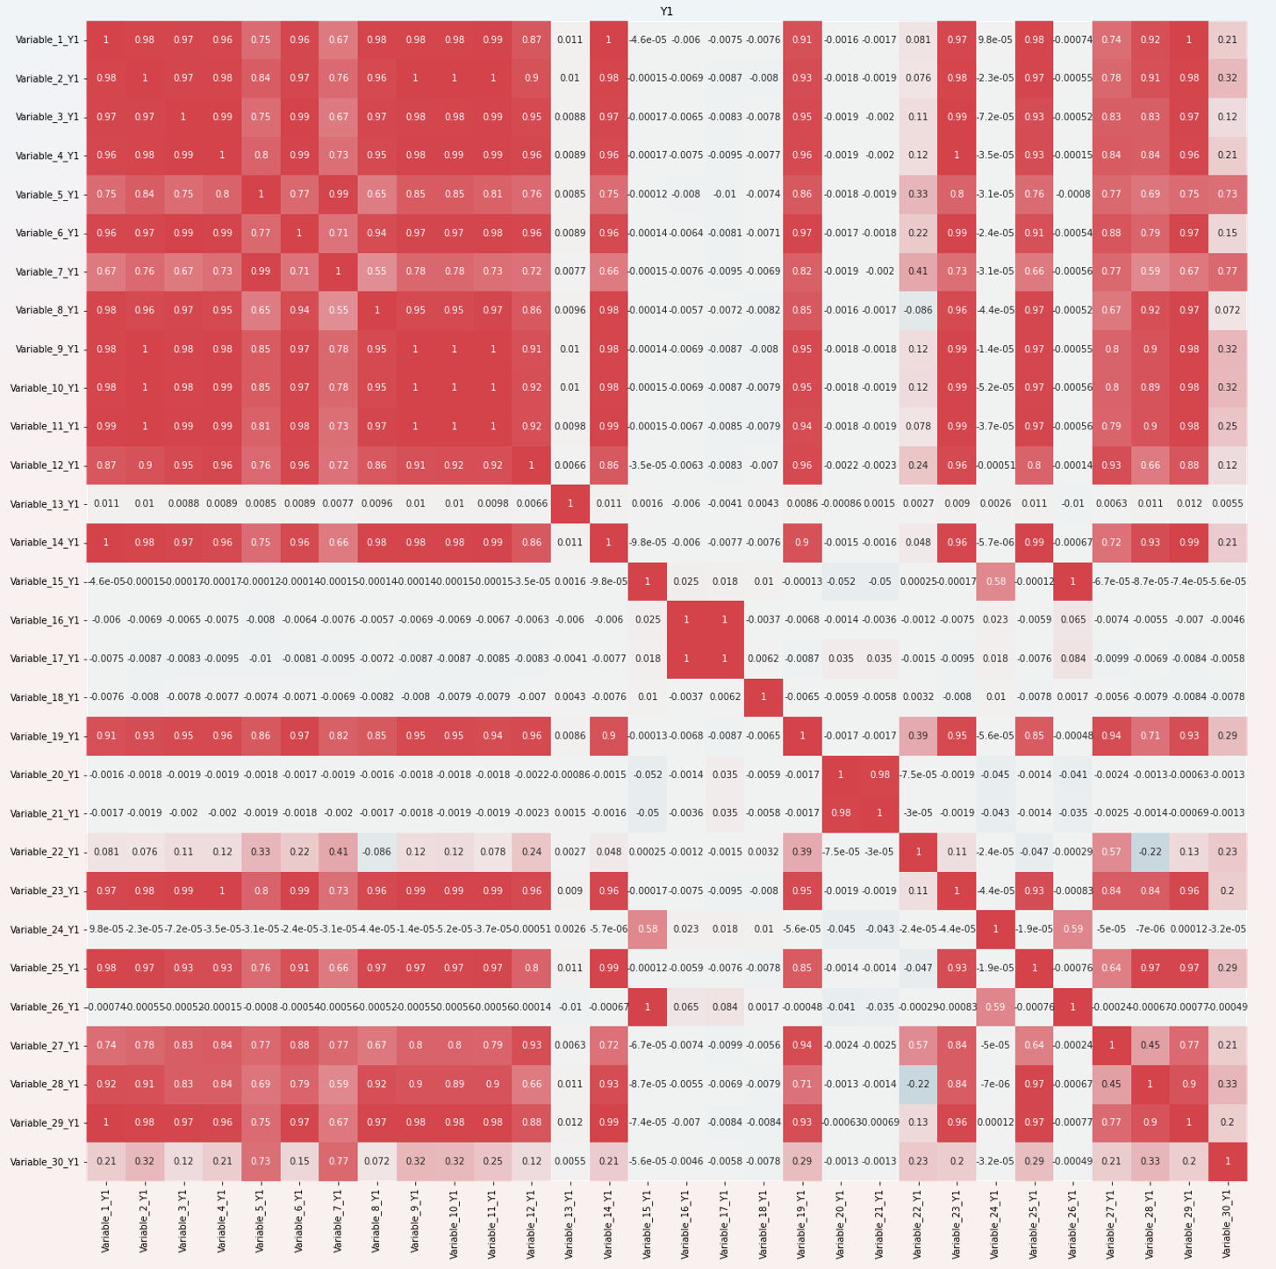
2. Exploratory Data Analysis (EDA)
Visualization – heatmap
correlation between
all independent
continuous variables
in Y1
Red: 1
White: 0
Blue: -1

Slide 16
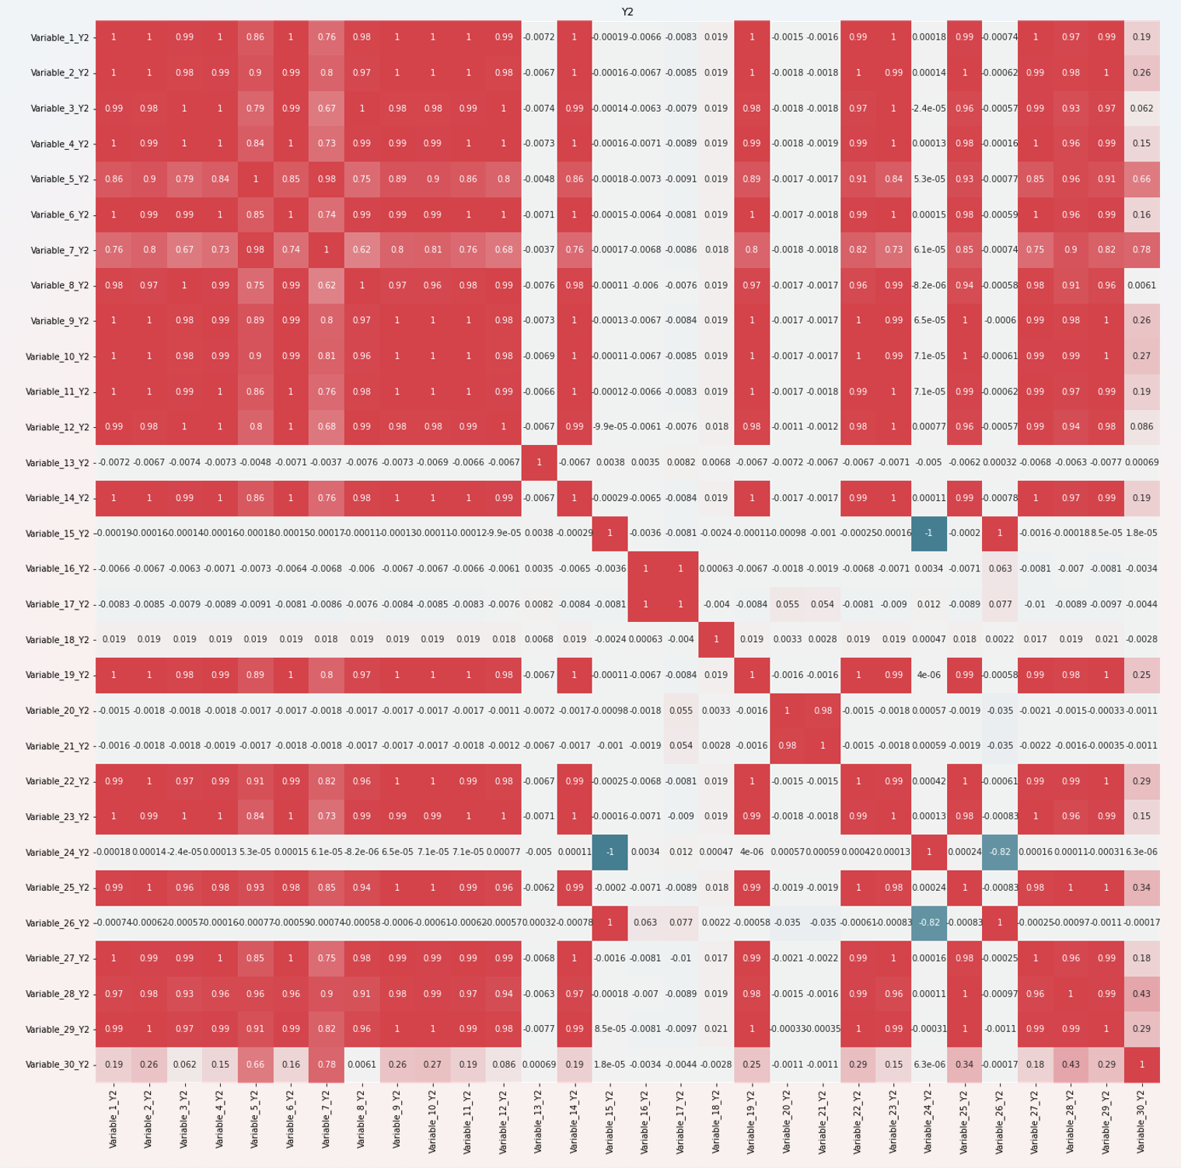
2. Exploratory Data Analysis (EDA)
Visualization – heatmap
correlation between
all independent
continuous variables
in Y2
Red: 1
White: 0
Blue: -1

Slide 17
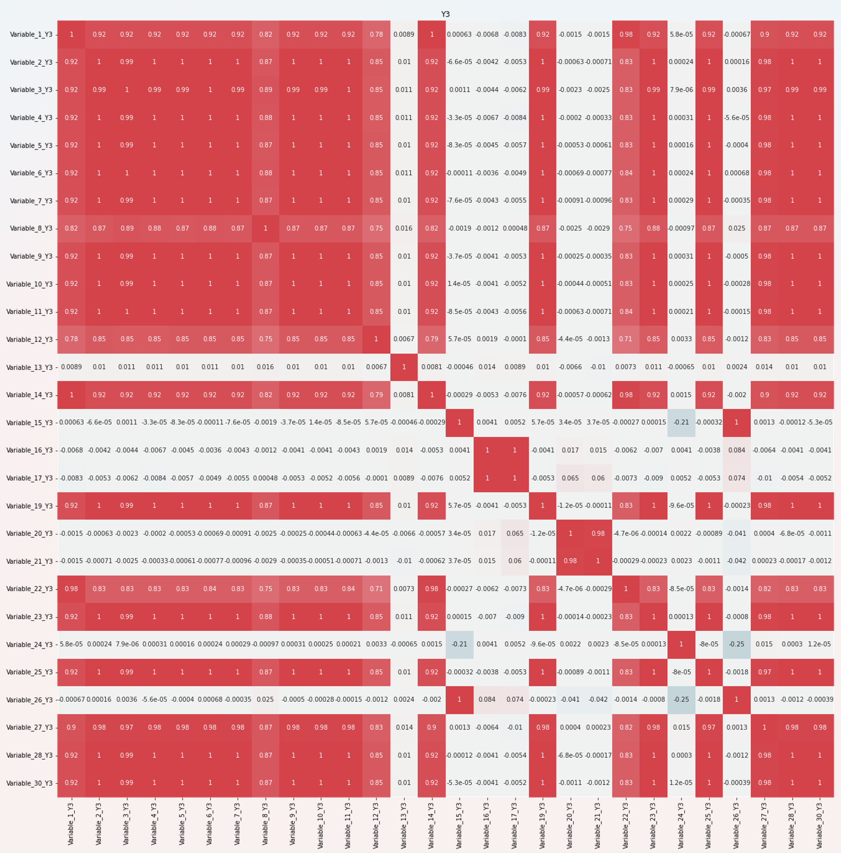
2. Exploratory Data Analysis (EDA)
Visualization – heatmap
correlation between
all independent
continuous variables
in Y3
Red: 1
White: 0
Blue: -1

Slide 18
Overview
Introduction and Purpose
Exploratory Data Analysis (EDA)
Feature Selection
Feature Engineering
Model Fitting and Tuning
Model Evaluation
Alternative Automated Approach: AutoViML
Conclusion

Slide 19
3. Feature Selection
Overview
Train-validation-test split
Missing data and outlier handling (4 methods)
Removing columns with more than 20% missing data, and then list-wise removing
Removing columns with more than 40% missing data, and then list-wise removing
Imputation with mean
Imputation using regression
The 4 methods are evaluated with a simple classification model – to choose the best
Feature selection based on correlation between features (unsupervised)
Feature selection based on statistical relationship between features and outcome (supervised)

Slide 20
3. Feature Selection
Overview
Train-validation-test split
Missing data and outlier handling (4 methods)
Removing columns with more than 20% missing data, and then list-wise removing
Removing columns with more than 40% missing data, and then list-wise removing
Imputation with mean
Imputation using regression
The 4 methods are evaluated with a simple classification model – to choose the best
Feature selection based on correlation between features (unsupervised)
Feature selection based on statistical relationship between features and outcome (supervised)

Slide 21
3. Feature Selection
Overview
Train-validation-test split
Missing data and outlier handling (4 methods)
Removing columns with more than 20% missing data, and then list-wise removing
Removing columns with more than 40% missing data, and then list-wise removing
Imputation with mean
Imputation using regression
The 4 methods are evaluated with a simple classification model – to choose the best
Feature selection based on correlation between features (unsupervised)
Feature selection based on statistical relationship between features and outcome (supervised)

Slide 22
3. Feature Selection
Missing data and outlier handling – outlier removing
Outliers are handled before missing data
Mean/Regression imputation rely highly on sample statistics (mean, standard deviation, etc.)
With extreme outliers, mean is not affected too much (large sample size, 20k+)
With extreme outliers, however, standard deviation is highly inflated (square in its formula)
With extreme outliers, therefore, imputation could be highly biased
Method of handling missing data
Not given contextual information on the variables (no actual variable names)
Capping out values beyond 2 standard deviations from the mean

Slide 23
3. Feature Selection
Missing data and outlier handling – method 1 & 2
Columns with many missing data
Most Y3 columns have the most missing data (> 40%)
Most Y2 columns have the second most missing data (> 20%)
These data are missing due to experimental design – Missing Completely At Random (MCAR)
Removing the columns causes no bias
Listwise removing
After removing those columns, all rows with missing data are removed

Slide 24
3. Feature Selection
Missing data and outlier handling – method 3
Each missing data is imputed, instead of removed
Imputed value is the mean of the corresponding column
Cons:
reduced variance,
which leads to reduced correlation to other variables
Pros:
cheap algorithm
preserved sample size

Slide 25
3. Feature Selection
Missing data and outlier handling – choosing the best method
Only one method will be chosen
The 4 methods used will be evaluated with a simple classification model
Choose the one with best performance
Evaluated after the 4 datasets are ready for model fitting
Each datasets go through similar process of feature selection and feature engineering

Slide 26
3. Feature Selection
Overview
Train-validation-test split
Missing data and outlier handling (4 methods)
Removing columns with more than 20% missing data, and then list-wise removing
Removing columns with more than 40% missing data, and then list-wise removing
Imputation with mean
Imputation using regression
The 4 methods are evaluated with a simple classification model – to choose the best
Feature selection based on correlation between features (unsupervised)
Feature selection based on statistical relationship between features and outcome (supervised)

Slide 27
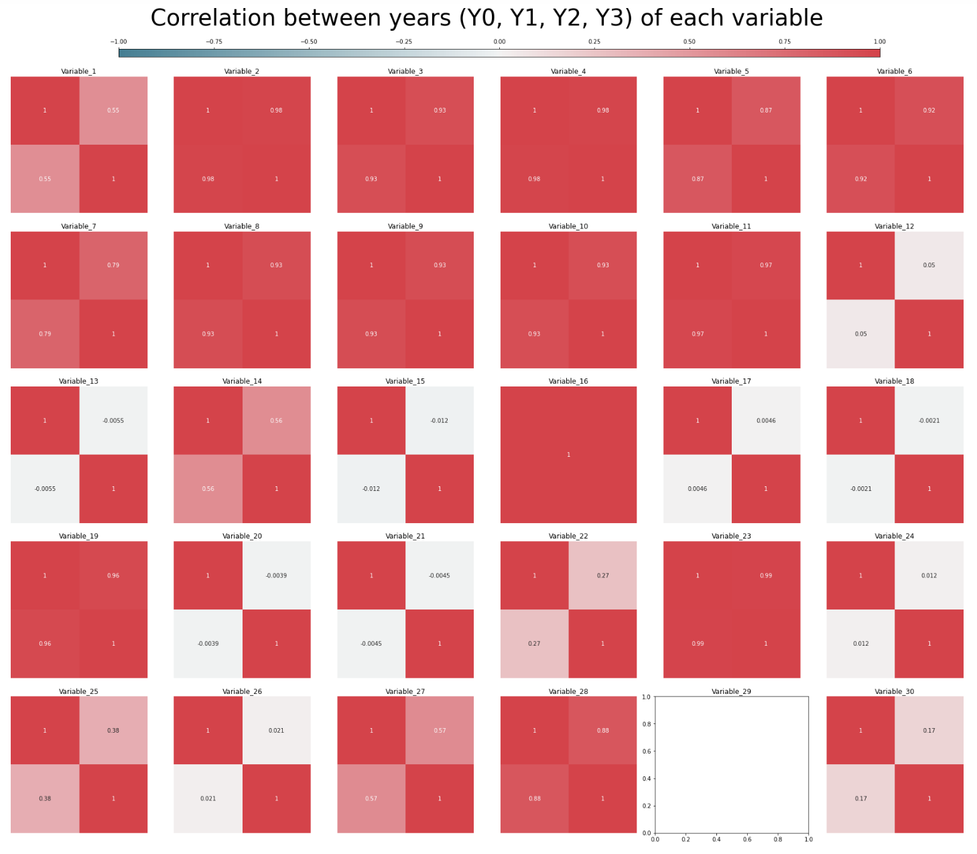
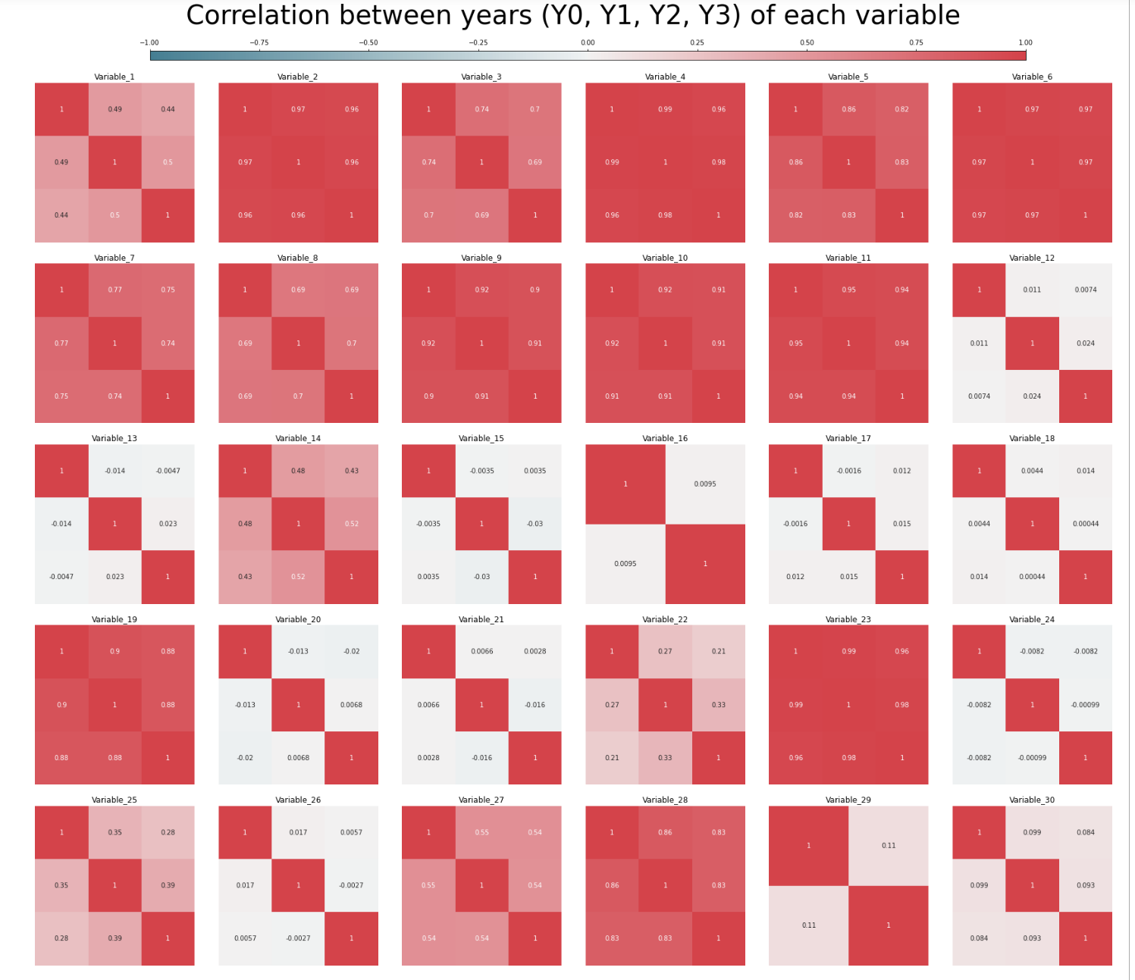
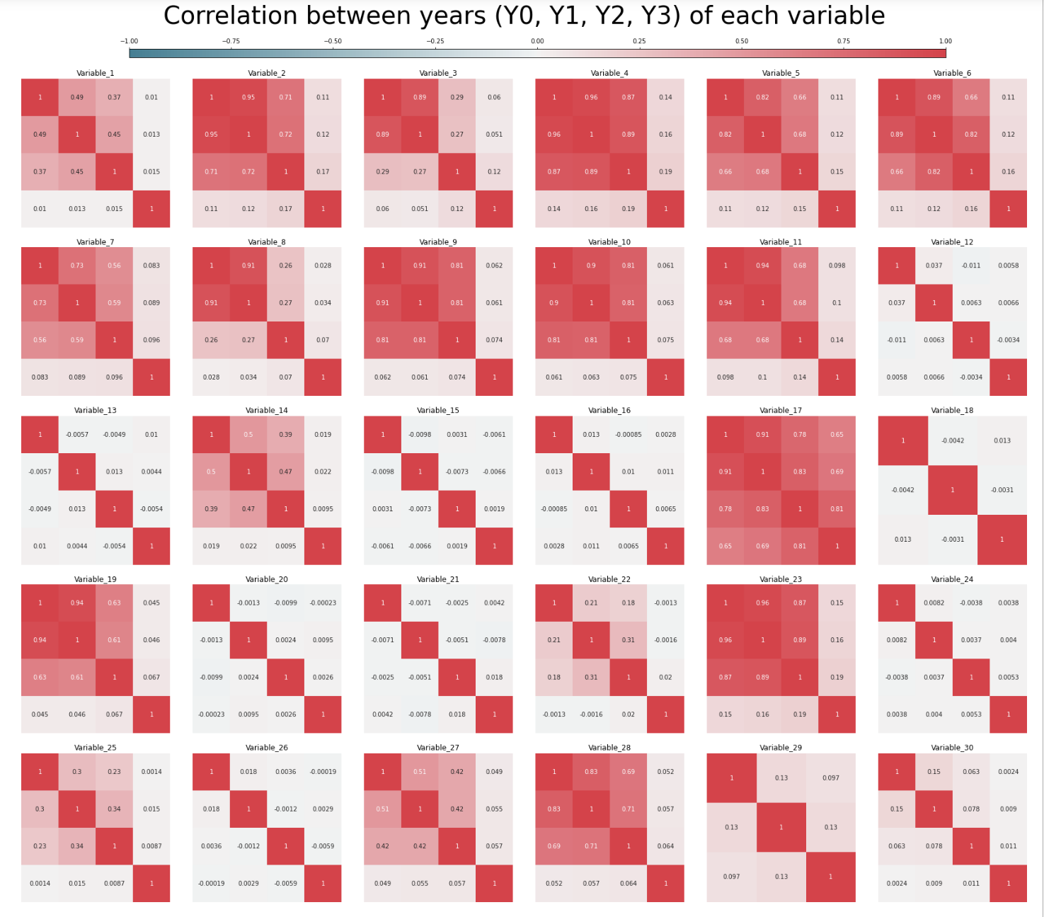
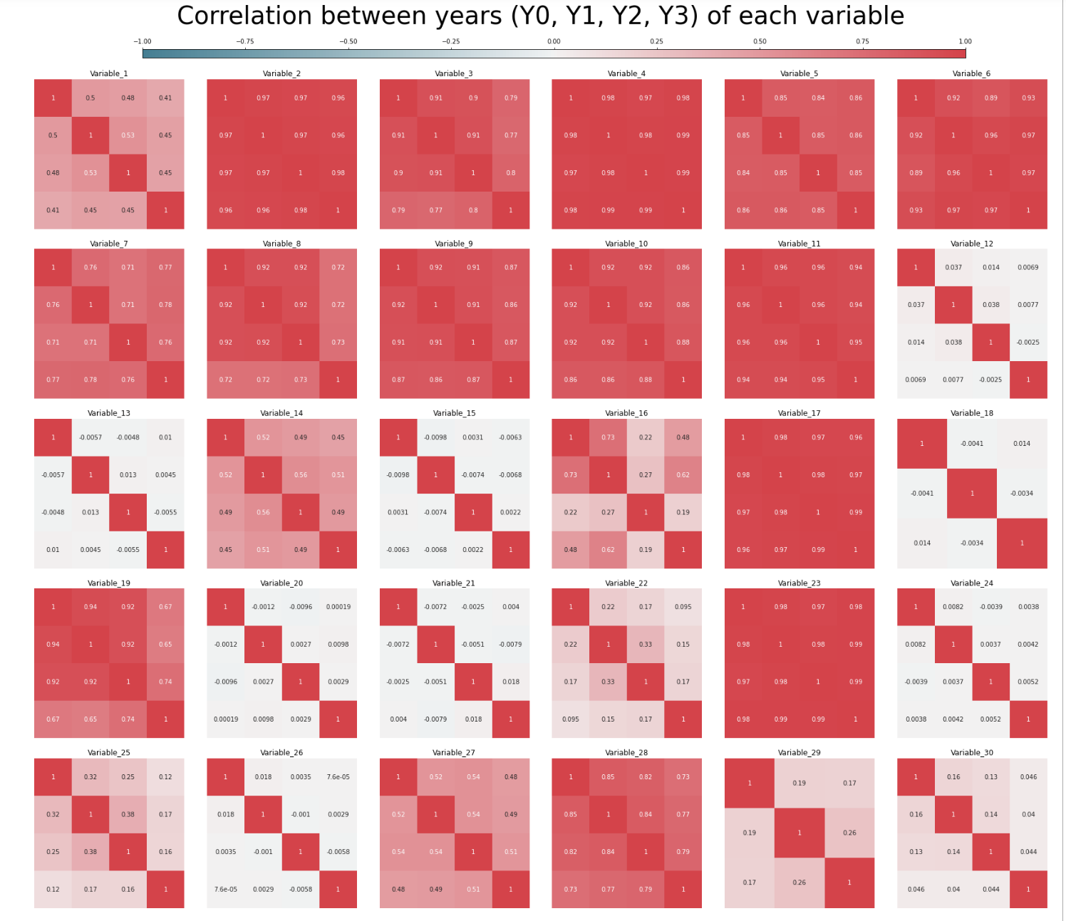
3. Feature Selection
Overview
Train-validation-test split
Missing data and outlier handling (4 methods)
Removing columns with more than 20% missing data, and then list-wise removing
Removing columns with more than 40% missing data, and then list-wise removing
Imputation with mean
Imputation using regression
The 4 methods are evaluated with a simple classification model – to choose the best
Feature selection based on correlation between features (unsupervised)
Feature selection based on statistical relationship between features and outcome (supervised)

Slide 28
3. Feature Selection
Overview
Train-validation-test split
Missing data and outlier handling (4 methods)
Removing columns with more than 20% missing data, and then list-wise removing
Removing columns with more than 40% missing data, and then list-wise removing
Imputation with mean
Imputation using regression
The 4 methods are evaluated with a simple classification model – to choose the best
Feature selection based on correlation between features (unsupervised)
Feature selection based on statistical relationship between features and outcome (supervised)

Slide 29
3. Feature Selection
Feature selection – based on relation to outcome
ANOVA correlation coefficient
Linear assumption not checked (likely not satisfied)
Measure the correlation between each feature and the outcome
Statistically significant considered with α=0.05
Kendall’s rank coefficient
Non-parametric test
Statistically significant considered with α=0.05
Used the union of significant features from the two tests above
Potentially failed assumptions
Classification models not affected much with low correlated features included

Slide 30
Overview
Introduction and Purpose
Exploratory Data Analysis (EDA)
Feature Selection
Feature Engineering
Model Fitting and Tuning
Model Evaluation
Alternative Automated Approach: AutoViML
Conclusion

Slide 31
4. Feature Engineering
Overview
Standardization of continuous variables
One-hot encoding categorical variables
Label encoding the outcome, risk rating
Choosing the best training dataset (out of 4)
Using the chosen method, process the validation dataset and testing dataset

Slide 32
4. Feature Engineering
Overview
Standardization of continuous variables
One-hot encoding categorical variables
Label encoding the outcome, risk rating
Choosing the best training dataset (out of 4)
Using the chosen method, process the validation dataset and testing dataset

Slide 33
4. Feature Engineering
Standardization of continuous variables
The (continuous) variables are rescaled
Their means are set to 0
Their variances are set to 1
This way, all variables evenly contribute to the model fitted

Slide 34
4. Feature Engineering
Overview
Standardization of continuous variables
One-hot encoding categorical variables
Label encoding the outcome, risk rating
Choosing the best training dataset (out of 4)
Using the chosen method, process the validation dataset and testing dataset

Slide 35
4. Feature Engineering
One-hot encoding categorical variables
A categorical variable with n categories are encoded as (n-1) binary variables
The 1st category is used as the baseline (zero for all the (n-1) binaries)
The (n-1)^{th} category is encoded as:
1 for the n^{th} binary variable
0 elsewhere
This way, libraries such as sklearn could process the data to fit model

Slide 36
4. Feature Engineering
Overview
Standardization of continuous variables
One-hot encoding categorical variables
Label encoding the outcome, risk rating
Choosing the best training dataset (out of 4)
Using the chosen method, process the validation dataset and testing dataset

Slide 37
4. Feature Engineering
Label encoding the outcome
The outcome, risk rating, takes the values 1-17
They are encoded to start from 0
As required by xgboost library
So, the values are all subtracted by 1.

Slide 38
4. Feature Engineering
Overview
Standardization of continuous variables
One-hot encoding categorical variables
Label encoding the outcome, risk rating
Choosing the best training dataset (out of 4)
Using the chosen method, process the validation dataset and testing dataset

Slide 39
4. Feature Engineering
Choosing the best training dataset
The validation dataset is treated with the same procedures
4 validation datasets, each mimicking the procedures done on the corresponding training data
Each (of the 4) training dataset fitted with a simple decision tree model
The 4 resulting models are evaluated in terms of predicting accuracy
The best performing dataset:
Dataset #4 (missing data handled with regression imputation)

Slide 40
4. Feature Engineering
Overview
Standardization of continuous variables
One-hot encoding categorical variables
Label encoding the outcome, risk rating
Choosing the best training dataset (out of 4)
Using the chosen method, process the validation dataset and testing dataset

Slide 41
4. Feature Engineering
Prepare the final validation dataset and testing dataset
Repeated all procedures done on training dataset #4
Outlier removal
Regression imputation
Feature selection (unsupervised & supervised)
Standardization
Encoding
The finalized training, validation, and testing data are ready for model fitting, validating, and testing

Slide 42
Overview
Introduction and Purpose
Exploratory Data Analysis (EDA)
Feature Selection
Feature Engineering
Model Fitting and Tuning
Model Evaluation
Alternative Automated Approach: AutoViML
Conclusion

Slide 43
5. Model Fitting and Tuning
Overview
Choosing well performance models
Classification tree (basic)
Random forest
Bagging
Logistic regression
kNN
Gradient boosting
Tuning selected models

Slide 44
5. Model Fitting and Tuning
Overview
Choosing well performance models
Classification tree (basic)
Random forest
Bagging
Logistic regression
kNN
Gradient boosting
Tuning selected models

Slide 45
5. Model Fitting and Tuning
Choosing well performance models
Fitting most of the popular classification models
Model hyperparameters hardly modified
Well-performing models are chosen to further tune
Well-performing models:
Classification tree (basic)
Random forest (chosen for further tuning)
Bagging
Logistic regression
kNN
Gradient boosting (chosen for further tuning)

Slide 46
5. Model Fitting and Tuning
Overview
Choosing well performance models
Classification tree (basic)
Random forest
Bagging
Logistic regression
kNN
Gradient boosting
Tuning selected models

Slide 47
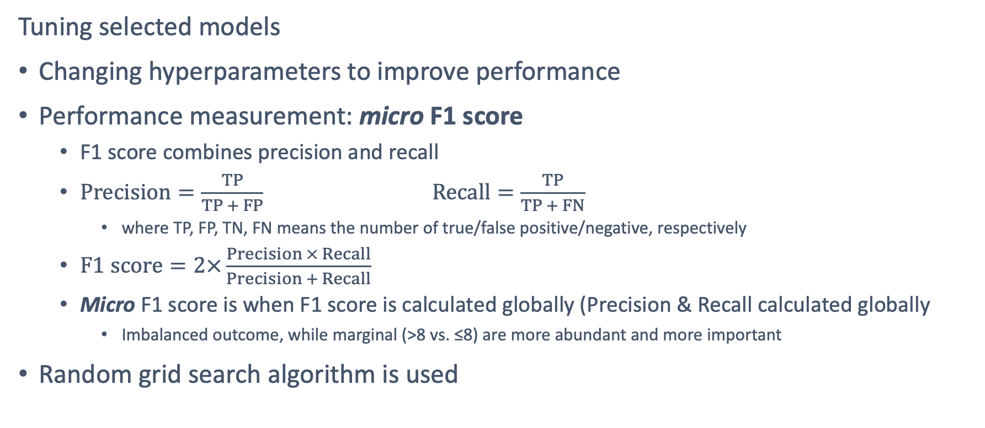
5. Model Fitting and Tuning
Tuning selected models
Changing hyperparameters to improve performance
Performance measurement: micro F1 score
F1 score combines precision and recall
$Precision=\frac{TP}{TP + FP}$ $Recall=\frac{TP}{TP + FN}$
where TP, FP, TN, FN means the number of true/false positive/negative, respectively
$F1 score=2×\frac{Precision × Recall}{Precision + Recall}$
Micro F1 score is when F1 score is calculated globally (Precision & Recall calculated globally
Imbalanced outcome, while marginal (>8 vs. ≤8) are more abundant and more important
Random grid search algorithm is used

Slide 48
Overview
Introduction and Purpose
Exploratory Data Analysis (EDA)
Feature Selection
Feature Engineering
Model Fitting and Tuning
Model Evaluation
Alternative Automated Approach: AutoViML
Conclusion

Slide 49
6. Model Evaluation
Overview
Test model performance using the test dataset

Slide 50
6. Model Evaluation
Test model performance using the testing dataset
The models have never “seen” the testing dataset
Testing dataset is like new data that the models attempt to predict on
The model generalizes if it performs equally well on the testing dataset
Random forest model:
F1 score validated: 0.2277
F1 score on testing: 0.2271
Gradient boosting model:
F1 score validated: 0.2274
F1 score on testing: 0.2278

Slide 51
Overview
Introduction and Purpose
Exploratory Data Analysis (EDA)
Feature Selection
Feature Engineering
Model Fitting and Tuning
Model Evaluation
Alternative Automated Approach: AutoViML
Conclusion

Slide 52
7. Alternative Automated Approach: AutoViML
Overview
Automation with only a few lines of code
Model visualization (EDA)
Feature selection and feature engineering
Model fitting
Detailed reports and procedure provided
Automatically pulling reports
Visualization included
High accuracy
Accuracy: 0.23, comparable and even slightly better than manual approach

Slide 53
Overview
Introduction and Purpose
Exploratory Data Analysis (EDA)
Feature Selection
Feature Engineering
Model Fitting and Tuning
Model Evaluation
Alternative Automated Approach: AutoViML
Conclusion

Slide 54
8. Conclusion
Machine learning models are used to predict risk rating for clients
The dataset is prepared by:
Handling missing data and outliers, selecting features
Standardizing and encoding
Random forest and Gradient boosting models are fitted and fine tuned
Both models generalize on the testing dataset
Both models yield an micro F1 score of approximately 0.23
Automated machine learning approach realized using AutoViML

Slide 55
The End
Thanks for watching!
By Peter Lee

